Slide 1

BioOhio
November 5, 2013
US DOL TAACCCT Round 2 Grant
Starts: October 1, 2012
Ends: September 30, 2016

Slide 2


BIOTECH EXPANSION
Market Factors
Green | Energy | Health | Food
Water purification | Bioenergy | Molecular design | Natural products
Air purification | Biodiesel | Nanomedicine | Biotics
Recycled Bio mass | Cellulosic ethanol | Regenerative | Anti-oxidants
 | Hydrogen | Personalized medicine | Agricultural bioprocessing
Heal, Fuel, Feed the World!

Slide 3
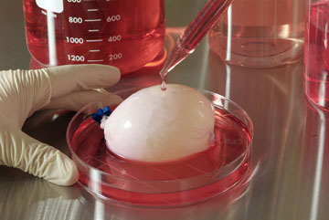
Building the Future
Traditional Segments- Agricultural, Industrial, Environmental Medical and Health
New Interface bio/nonbio segments- overlapping spheres of emerging technologies
Academic & Medical Research infrastructures- magnets for bioscience companies
Home grown industry needs- capital, educated manpower & an efficient, effective business environment
It’s a Bladder!
Our BT graduates helped!

Slide 4
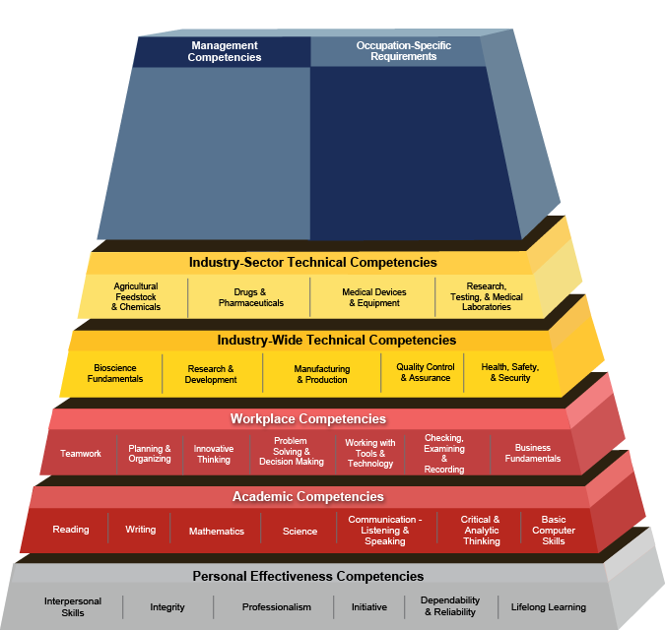
Management/Job Specific
Job Technical
Job Knowledge
Sector
Technical
Workplace
Basic Academics
People Skills
US DOL BIOSCIENCE COMPETENCY MODEL
http://www.careeronestop.org/competencymodel/pyramid.aspx?BIOSCI=Y&ES=Y&EST=bioscience+model

Slide 5
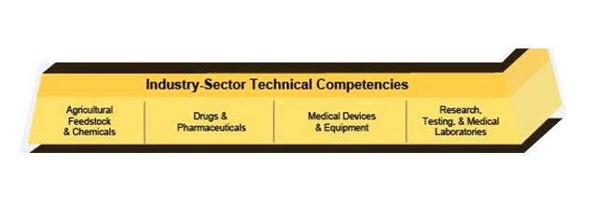
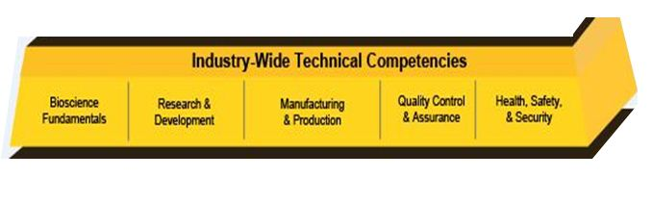
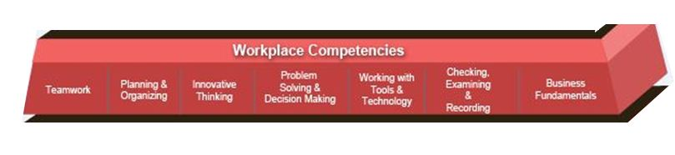
Basic Credential Elements
Sector
Job Knowledge
Technical Skill
CERTS THAT SUPPORT THIS BAR

Slide 6
Systems Approach
Summer enrichment programs for middle and high school students
Articulations from high school to 2 year colleges
Community College Regional Partnerships 1+1
Internships for all levels (H.S., college/4 year and post. grad.)
US DOL approved Biotechnology Apprenticeships/Internships
Seamless articulations from 2 year schools to 4 year schools 2+2
Reverse articulations (degreed students come to 2yr colleges for hard skills training)
Short (120 hours) non-credit programs for technical operators
Distance learning hybrids- More Simulations & Gaming

Slide 7
Careers – Possibilities & Preparation
Find Creative Ways to Partner
Assure Job Skills & Job Seeking Skills are Aligned
Start Up Co. | Private/Public | Not- for- Profit
Internship | Secondment | Job share
Hard Skills | Soft Skills | Job Prep Skills
Technical competence | Teamwork and communication | Resume writing, interviewing

Slide 8
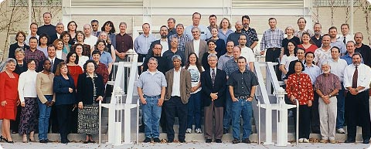
Talent Required
Scientists, clinicians, technicians, chemists, biologists, pharmacologists, toxicologists, research associates, regulatory experts, manufacturing & production teams, packaging, ancillary support teams etc.,
Bioscience jobs on average out pay private sector jobs by 1.7 X

Slide 9
Wage and Salaried Workers in Pharmaceutical & Medicine Manufacturing Projected change, 2008-2018
 | Employment: 2008 |  | Percent Change:
Occupation | Number | Percent | 2008-2018
All Occupations | 289.8 | 100 | 6.1
Management, business, and financial occupations | 51.9 | 17.9 | 3.9
Professional and related occupations * | 91.1 | 31.4 | 9.8 *
Sales and related occupations | 6.9 | 2.4 | -3.8
Office and administrative support occupations | 31.4 | 10.8 | -1.6
Installation, maintenance, and repair ** | 12.4 | 4.3 | 9.2 **
Production occupations *** | 79.5 | 27.5 | 9.3 ***
Transportation and material moving occupations | 12.1 | 4.2 | -7.5
NOTE: Employment in thousands; Columns may not add to total due to omission of occupations with small employment. SOURCE: BLS National Employment Matrix, 2008-18.

Slide 10
Trade Adjustment Assistance Community College and Career Training
What is a DOL TAACCCT Round II Grant?
  Grants are the second installment ($500 million) of a $2 billion, four-year initiative
  Funds to expand and improve delivery of education and career training programs- completed in two years or less
  Suited for workers who are eligible for training under the TAA for Workers program
  Prepare program participants for employment in high-wage, high-skill occupations

Slide 11
Need for the Biosciences Consortium
No national program for the acquisition of an industry-recognized credential associated with core skills
Public workforce systems are not geared toward matching skills and preparation with previous training and industry experience

Slide 12
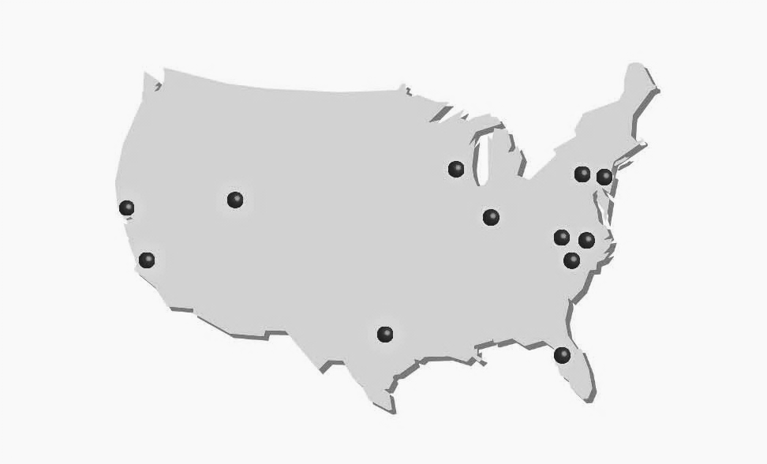
Grant Value: $ 14, 998, 474
City College of San Francisco
Madison Area Tech
Montgomery
Bucks
Ivy Tech
Salt Lake
Forsyth Tech
Alamance
LA Valley
Rowan-Cabarrus
Austin
St Petersburg
Hubs by color
Lab Skills
Medical Devices
Biomanufacturing
Learning
Recipients : 12 colleges, 8 states

Slide 15
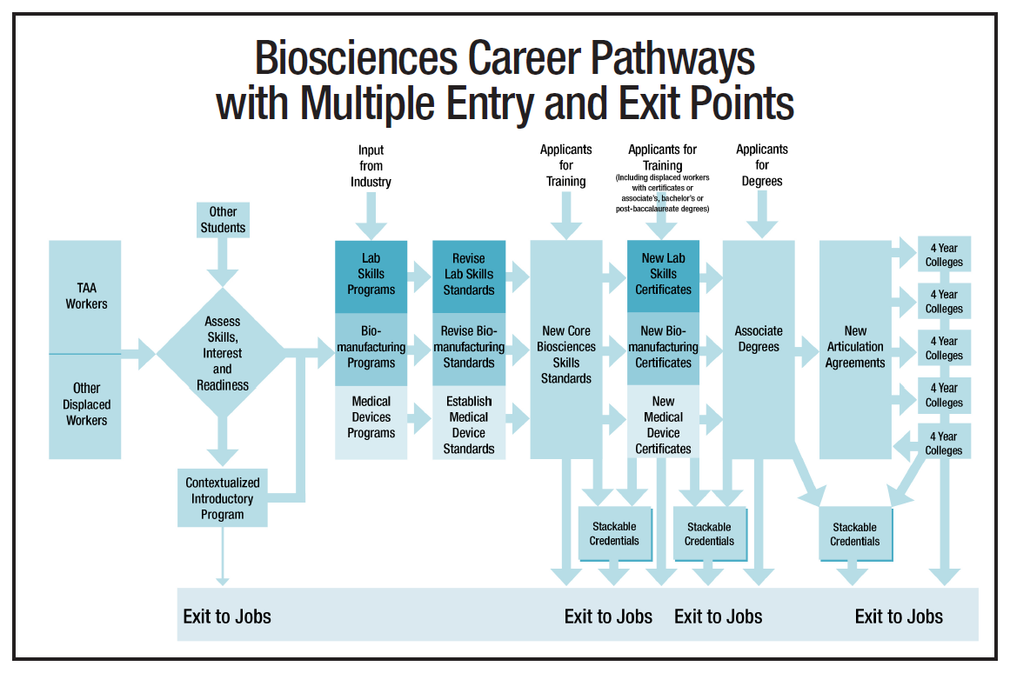
Project Overview

Slide 16
Medical Devices Hub

Slide 17

Overcoming Barriers
Age
Time away from classroom
Family responsibilities
Transportation
Intimidation by biosciences
Limited resources
Language & math out of context
Self confidence

Slide 18
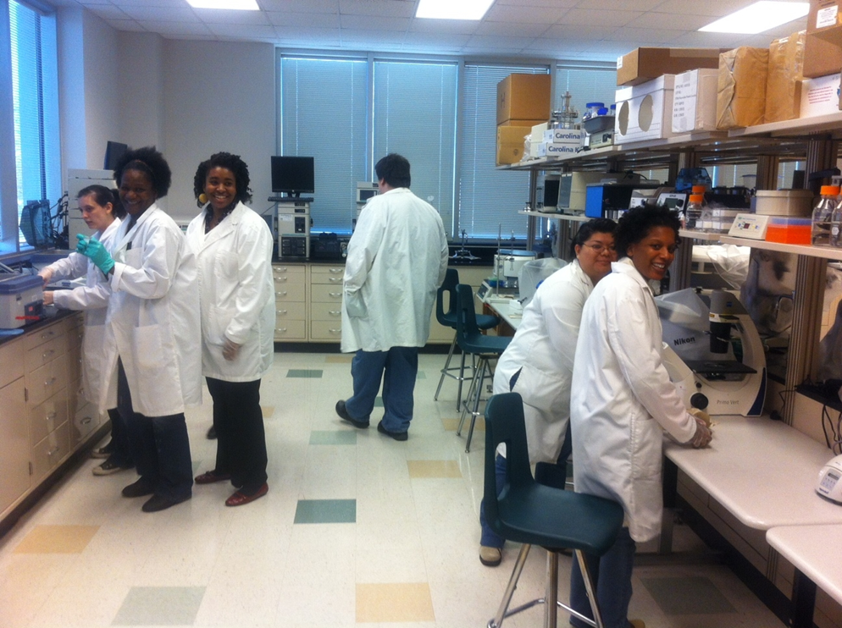
What is in it for Companies?
The improved assessment of potential employees from a workforce prospective
An increased source of qualified employees
An Industry Recognized harmonized core of skill standards & credentials

